Slide 1

Science Center
Rebecca Champagne
Jungi Chen
Qingyu Gao

Slide 2
Agenda
Insights on Membership Data
Renewal Rate
Tool for Renewal Report
Implementation of New System

Slide 3
Insights on Membership Data

Slide 4
Location of Members
31 States
Primarily Michigan
98.54%
Illinois, Indiana and Ohio
0.40%
Rest of States
1.06%

Slide 5
Members by Michigan Counties
Top counties in Michigan
Ingham – 60.39% of members
Eaton – 14.51% of members
Clinton – 9.06% of members
Shiawassee – 2.91% of members

Slide 6
Tableau Map
Presentation of Tableau Map

Slide 7
Participation in Science Center Events
95% of participation from Top 4 counties
Includes
Birthday Parties
Labs
Homeschool Program
Preschool Program

Slide 8
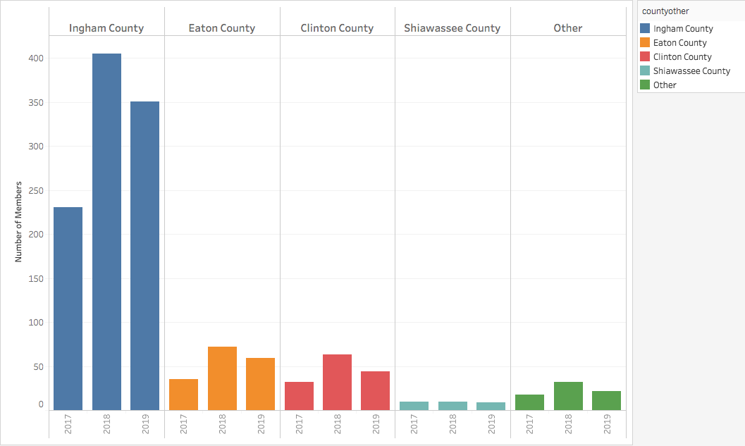
Participation by County

Slide 9
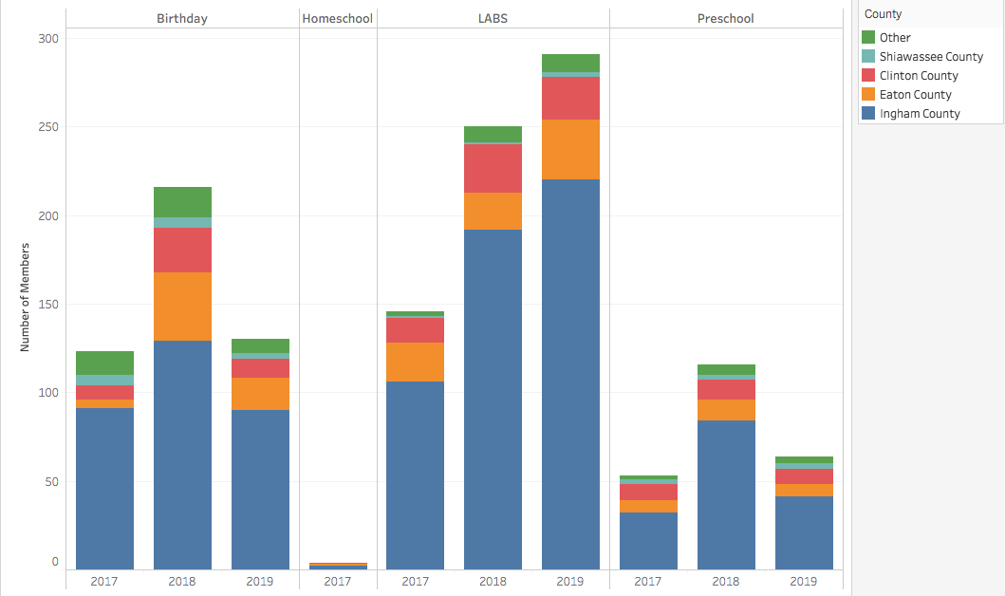
Participation in Different Event Type

Slide 10
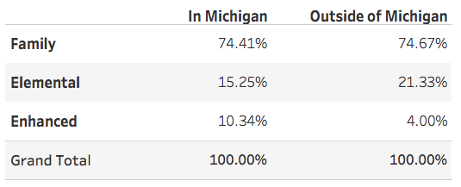
Members by Category
Most memberships are Family
In and out of state
Category Breakdown:

Slide 11
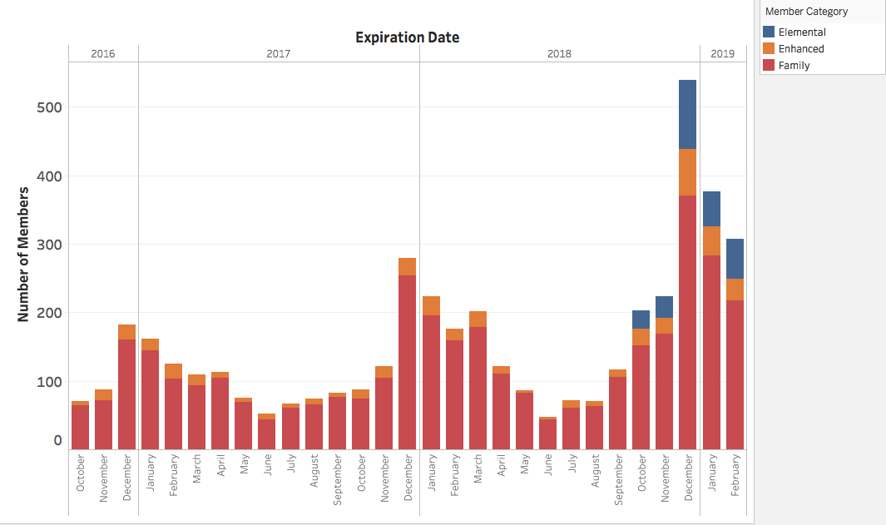
Changing of Membership Categories

Slide 12
Scholarship Members
411 Total Scholarship Members
407 Located in Michigan
Top 5 Counties (370 scholarship members)
Ingham
Eaton
Clinton
Jackson
Shiawassee

Slide 13
Ages of Children at Museum
Core ages:
5-10 years old
47.12%
0-4 years old
35.18%
Secondary ages:
11-18 years old
17.7%

Slide 14
Renewal Rate

Slide 15
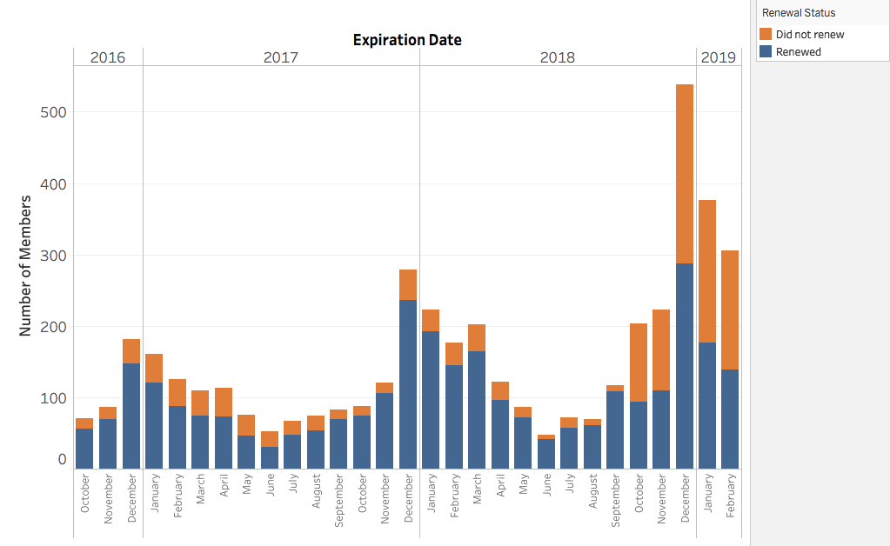
Renewals Over Time

Slide 16
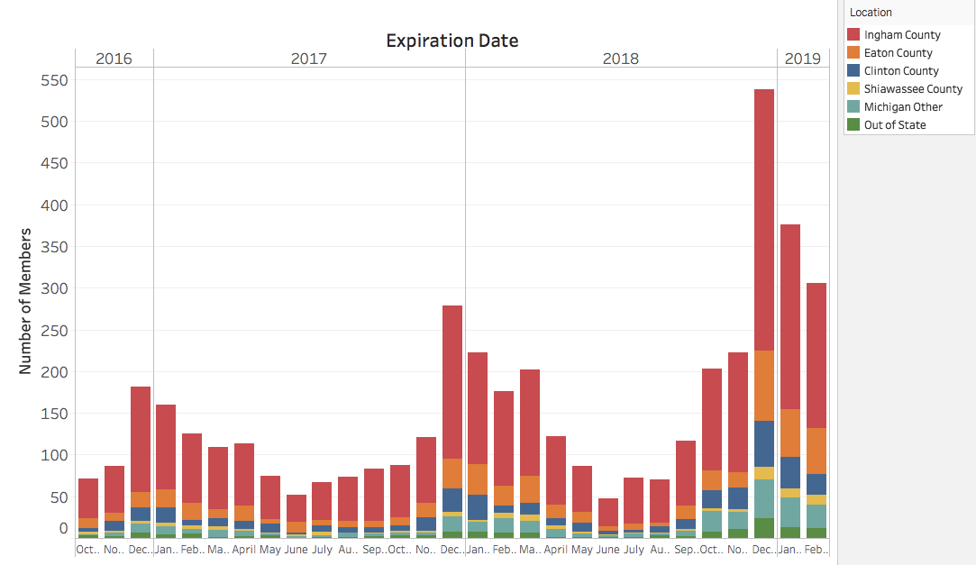
Renewal Over Time by County

Slide 17
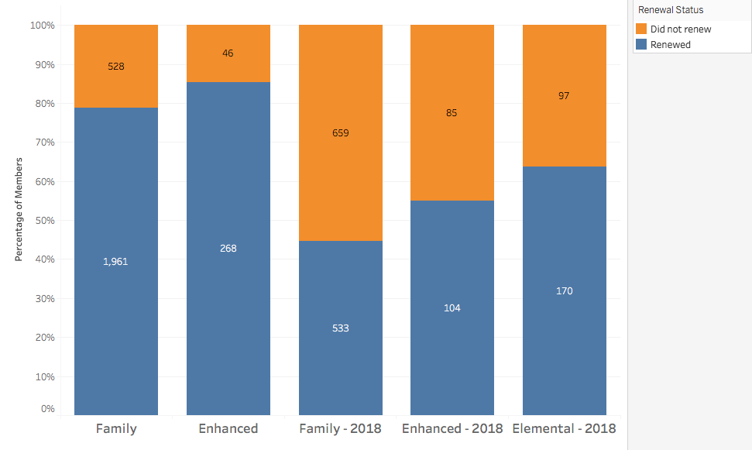
Renewals by Membership Category

Slide 18
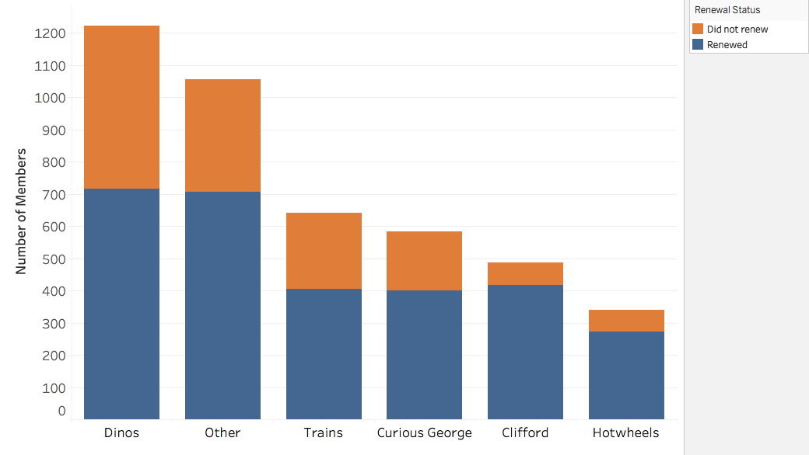
Participation in Traveling Exhibits

Slide 19
Tableau Renewals
Presentation of Tableau Renewal Graphs

Slide 20
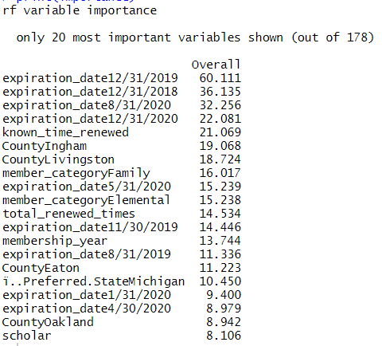
Predicting Late Renewals
Notes:
Junyi: We did a random forest model to see what parameters correlate strongly with late renewals. These are the customer traits that are most correlated with a high late renewal rate. It seems like members that have expiration dates at the end of the year have the most correlation. People in Ingham and Livingston as well as members with high membership years. we think that the fact that the two counties and large membership pool of family and elemental are skewing the results but it would make sense to focus renewal efforts on them. The interesting parameters are membership years and december renewals.

Slide 21
Late Renew Member Type
Live in Ingham and Livingston county
Family/Elemental memberships
Has been a member for some time
Members that expire in May, August, and December

Slide 22
Tool for Renewal Report

Slide 23
Tool for Renewal Report
Tableau
Not for Profit License
$58 for a 2-year license
One user account, two devices
Easy to use

Slide 24
Implementation of New System

Slide 25
Implementing a New System
Data Quality
Spelling
Format
Complete Information
Data to Collect
Additional variables

Slide 26
Recommendations for New System
Track number of visits per guest
Do guests buy a membership for one visit?
Track County as Data Attribute
Track touchpoints with members
Mailers, promotions, etc...

Slide 27
Future Exploration
Impression 5 Promotions on Renewal
Event Participation on Renewal
Additional Effects on Renewal Rate

Slide 28
Thank you!

